Slide 1
ICE-5121: MACHINE LEARNING
Dr. Mohammad Amzad Hossain
Associate Professor
Department of Information & Communication Engineering
Noakhali Science & Technology University
Notes:
Optimisation of the Beer Distribution Game

Slide 2
What is Machine Learning?
Machine learning is a branch of artificial intelligence (AI) and computer science that enables systems to learn and improve from experience without being explicitly programmed. Machine learning focuses on the use of data and algorithms to imitate the way that humans learn, gradually improving its accuracy.
Samuel, 1959: "Field of study that gives computers the ability to learn without being explicitly programmed”
Witten & Frank, 1999: “Learning is changing behaviors in a way that makes performance better in the future”
Notes:
Optimisation of the Beer Distribution Game

Slide 3
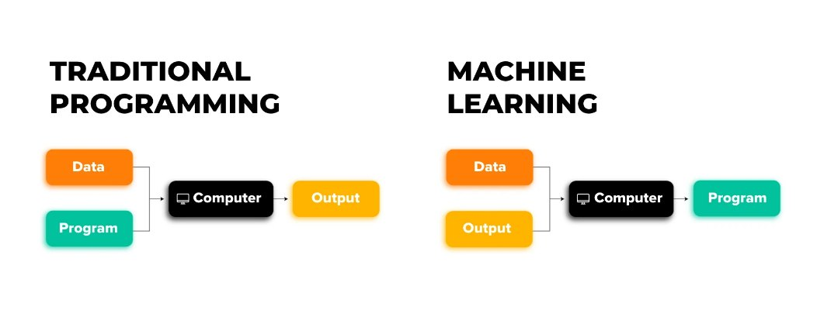
Traditional programming VS Machine Learning
Traditional programming is a manual process—meaning a person (programmer) creates the program. But without anyone programming the logic, one has to manually formulate or code rules.
In machine learning, on the other hand, the algorithm automatically formulates the rules from the data.
Fig. 1: Traditional programming VS Machine Learning
Notes:
Optimisation of the Beer Distribution Game

Slide 4
Goals of Machine Learning
Prediction: Machine learning goal is to build models that can accurately predict future outcomes or events based on historical data.
Classification: Machine learning is used to classify data into different categories or classes.
Clustering: Clustering involves grouping similar data points together.
Anomaly Detection: Machine learning helps identify unusual patterns in data, which can be crucial for fraud detection, network security, and quality control.
Notes:
Optimisation of the Beer Distribution Game

Slide 5
Goals of Machine Learning
Optimization: Machine learning can optimize processes and systems by finding the best possible solutions to problems.
Recommendation: Recommender systems are a common application of machine learning.
Pattern Recognition: Machine learning can identify complex patterns and relationships in data that might not be apparent to humans.
Notes:
Optimisation of the Beer Distribution Game

Slide 6
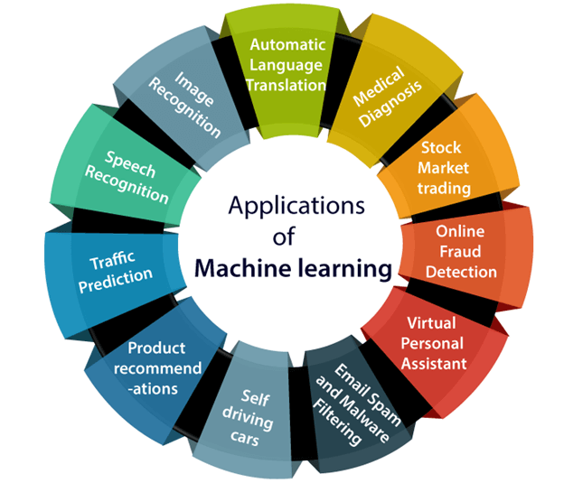
Applications of ML
Notes:
Optimisation of the Beer Distribution Game

Slide 7
Machine Learning techniques
Image Recognition: Image recognition is one of the most common applications of machine learning. It is used to identify objects, persons, places, digital images, etc. The popular use case of image recognition and face detection is, Automatic friend tagging suggestion: Facebook provides us a feature of auto friend tagging suggestion. It is based on the Facebook project named "Deep Face," which is responsible for face recognition and person identification in the picture.
Speech Recognition: Speech recognition is a process of converting voice instructions into text, and it is also known as "Speech to text", or "Computer speech recognition." At present, machine learning algorithms are widely used by various applications of speech recognition. Google assistant, Siri, Cortana, and Alexa are using speech recognition technology to follow the voice instructions. If we using Google, we get an option of "Search by voice," it comes under speech recognition, and it's a popular application of machine learning.
Notes:
Optimisation of the Beer Distribution Game

Slide 8
Machine Learning techniques
Traffic prediction: It predicts the traffic conditions such as whether traffic is cleared, slow-moving, or heavily congested with the help of two ways:
Real Time location of the vehicle form Google Map app and sensors
Average time has taken on past days at the same time.
Everyone who is using Google Map is helping this app to make it better. It
takes information from the user and sends back to its database to improve
the performance.
Product recommendations: Machine learning is widely used by various e-commerce and entertainment companies such as Amazon, Netflix, etc., for product recommendation to the user. Google understands the user interest using various machine learning algorithms and suggests the product as per customer interest.
Notes:
Optimisation of the Beer Distribution Game

Slide 9
Machine Learning techniques
Self-driving cars: One of the most exciting applications of machine learning is self-driving cars. Machine learning plays a significant role in self-driving cars. Tesla, the most popular car manufacturing company is working on self-driving car. It is using unsupervised learning method to train the car models to detect people and objects while driving.
Email Spam and Malware Filtering: Whenever we receive a new email, it is filtered automatically as important, normal, and spam. We always receive an important mail in our inbox with the important symbol and spam emails in our spam box, and the technology behind this is Machine learning. Below are some spam filters used by Gmail: Content Filter, Header filter, General blacklists filter, Rules-based filters, Permission filters
Virtual Personal Assistant: We have various virtual personal assistants such as Google assistant, Alexa, Cortana, Siri. As the name suggests, they help us in finding the information using our voice instruction. These virtual assistants use machine learning algorithms.
Notes:
Optimisation of the Beer Distribution Game

Slide 10
Machine Learning techniques
Online Fraud Detection: Machine learning is making our online transaction safe and secure by detecting fraud transaction.
Stock Market Trading: Machine learning is widely used in stock market trading. In the stock market, there is always a risk of up and downs in shares, so for this machine learning's long short term memory neural network is used for the prediction of stock market trends.
Agriculture: It's used for crop monitoring, yield prediction, and pest control.
Medical Diagnosis: In medical science, machine learning is used for diseases diagnoses. With this, medical technology is growing very fast and able to build 3D models that can predict the exact position of lesions in the brain. It helps in finding brain tumors and other brain-related diseases easily.
Notes:
Optimisation of the Beer Distribution Game

Slide 11
Machine Learning techniques
Automatic Language Translation: The technology behind the automatic translation is a sequence to sequence learning algorithm, which is used with image recognition and translates the text from one language to another language.
Environmental Science: It's used for climate modeling, pollution monitoring, and predicting natural disasters.
Notes:
Optimisation of the Beer Distribution Game

Slide 12
Machine Learning techniques
Supervised learning
Unsupervised learning
Semi supervised learning
Reinforcement learning
Notes:
Optimisation of the Beer Distribution Game

Slide 13
Supervised learning
Supervised learning is the types of machine learning in which machines are trained using well "labelled" training data, and on basis of that data, machines predict the output. The labelled data means some input data is already tagged with the correct output.
Supervised learning is a process of providing input data as well as correct output data to the machine learning model. The aim of a supervised learning algorithm is to find a mapping function to map the input variable(x) with the output variable(y).
Notes:
Optimisation of the Beer Distribution Game

Slide 14
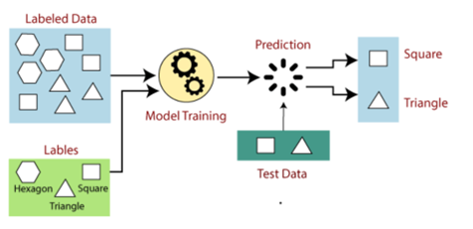
How Supervised Learning Works?
Notes:
Optimisation of the Beer Distribution Game

Slide 15
Steps Involved in Supervised Learning
First Determine the type of training dataset
Collect/Gather the labelled training data.
Determine the input features of the training dataset, which should have enough knowledge so that the model can accurately predict the output.
Split the training dataset into training dataset, test dataset, and validation dataset.
Determine the suitable algorithm for the model, such as support vector machine, decision tree, etc.
Execute the algorithm on the training dataset. Sometimes we need validation sets as the control parameters, which are the subset of training datasets.
Evaluate the accuracy of the model by providing the test set. If the model predicts the correct output, which means our model is accurate.
Notes:
Optimisation of the Beer Distribution Game

Slide 16
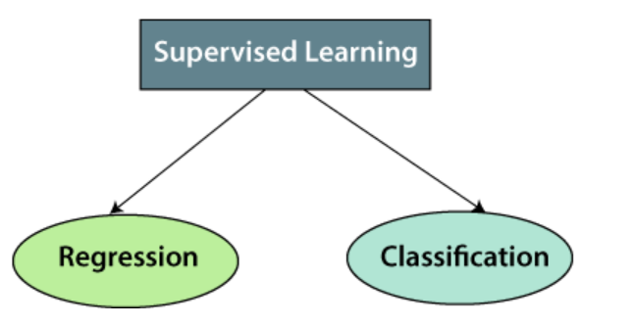
Types of supervised Machine learning Algorithms
Notes:
Optimisation of the Beer Distribution Game

Slide 17
Classification
Classification algorithms are used when the output variable is categorical, which means there are two classes such as Yes-No, Male-Female, True-false, etc.
Some popular classification algorithms:
Random Forest
Decision Trees
Logistic Regression
Support Vector Machines
Notes:
Optimisation of the Beer Distribution Game

Slide 18
Regression
Regression algorithms are used if there is a relationship between the input variable and the output variable. It is used for the prediction of continuous variables, such as Weather forecasting, Market Trends, etc.
Some popular Regression algorithms which come under supervised learning:
Linear Regression
Regression Trees
Non-Linear Regression
Polynomial Regression
Ireland
Virginia
Japan
California
H K/ Sing
Notes:
Optimisation of the Beer Distribution Game

Slide 19
Advantages of Supervised learning
With the help of supervised learning, the model can predict the output on the basis of previous experiences.
In supervised learning, we can get an exact idea about the classes of objects.
Supervised learning model helps us to solve various real-world problems such as fraud detection, spam filtering, etc.
Ireland
Virginia
Japan
California
H K/ Sing
Notes:
Optimisation of the Beer Distribution Game

Slide 20
Disadvantages of supervised learning
Supervised learning models are not suitable for handling the complex tasks.
Supervised learning cannot predict the correct output if the test data is different from the training dataset.
Training required lots of computation times.
In supervised learning, we need enough knowledge about the classes of object.
Ireland
Virginia
Japan
California
H K/ Sing
Notes:
Optimisation of the Beer Distribution Game

Slide 21
Unsupervised Machine learning
Unsupervised machine learning is a type of machine learning where the algorithm learns patterns and structures in data without explicit supervision or labeled examples.
In other words, in unsupervised learning, the algorithm is not provided with a specific target or output variable to predict, and it must discover the inherent structure and relationships within the data on its own.
The goal of unsupervised learning is to find the underlying structure of dataset, group that data according to similarities.
Ireland
Virginia
Japan
California
H K/ Sing
Notes:
Optimisation of the Beer Distribution Game

Slide 22
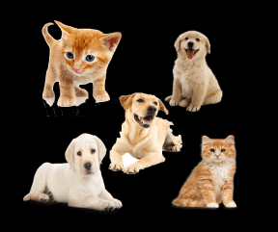
Unsupervised Machine learning
Example: Suppose the unsupervised learning algorithm is given an input dataset containing images of different types of cats and dogs. The algorithm is never trained upon the given dataset, which means it does not have any idea about the features of the dataset. The task of the unsupervised learning algorithm is to identify the image features on their own. Unsupervised learning algorithm will perform this task by clustering the image dataset into the groups according to similarities between images.
Ireland
Virginia
Japan
California
H K/ Sing
Notes:
Optimisation of the Beer Distribution Game

